Slide 1
Module-1-Optical Fiber
Lecture ppt
Presented
By
Dr. Dheeraj Bhardwaj
Department of Physics
BIT Mesra, Jaipur Campus

Slide 2
Differences Between Optical Fiber and Wireless Communication
Key words | Fiber Optic Communication | Wireless Communication
Speed | Due to higher Bandwidth (100MBPS), It is not affected like this and so gains higher speed. | The networks become heavily congested since all users of wireless network sharing the same bandwidth (10MBPS), So it becomes slower.
Distance | It is least affected by distance (Very low transmission loss) | wireless signals degrade proportionally with distance
Mobility and convenience | It need wired connection (Optical fiber) | It does not need any wired connection
Access in laminated areas | In any type of Hilly areas and Border areas Optical fiber Communication services work. | In some areas hilly areas and Border areas wireless services do not work.
Signal Interference | It has very low Signal Interference | It has significant signal Interference
Carrier wave | Normal Light or Laser Light are used as a carrier wave | RF/microwave are used as a carrier wave

Slide 3


Module-1
Elementary ideas of fiber optics and application of fiber optic cables.

Slide 4
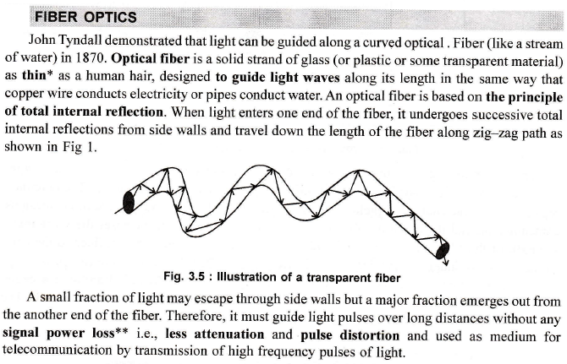

Slide 5

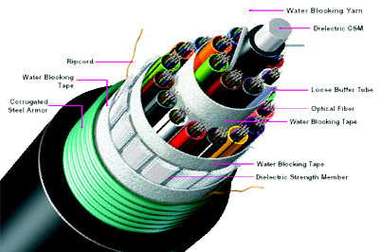
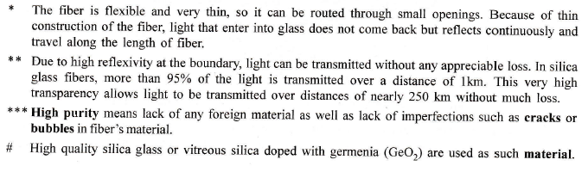
Poly urethane protective jacket
Cladding
Core

Slide 6
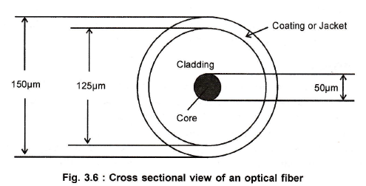
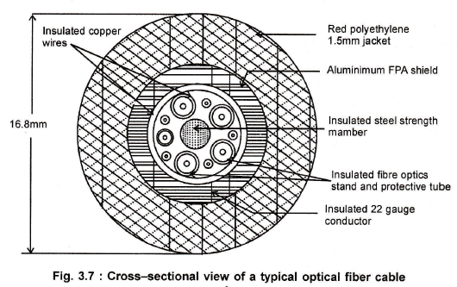

Slide 7
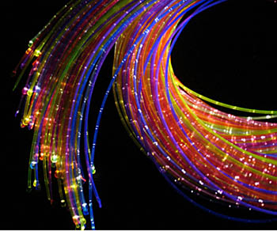
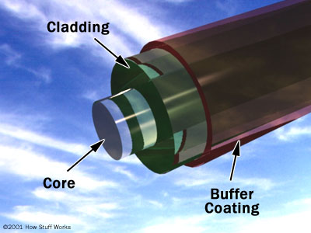
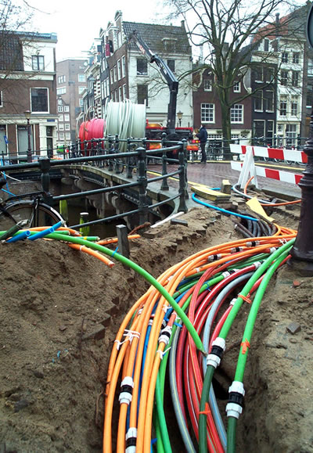
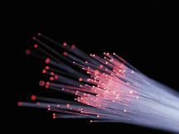
Fiber Optic Cables
SOURCE: SURFNET.NL

Slide 8
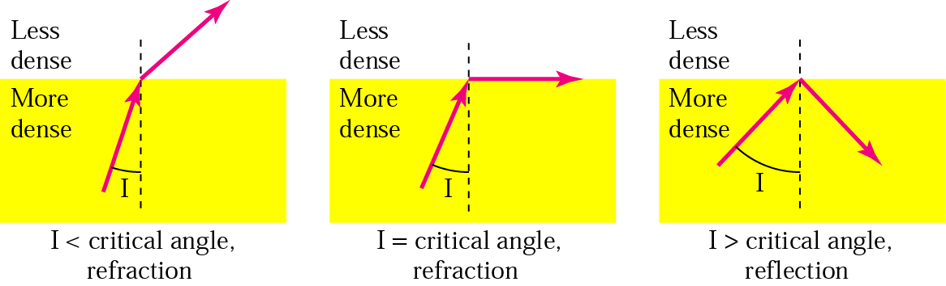
Total Internal Reflection
Physical Media

Slide 9
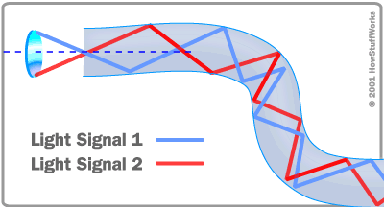
How Does an Optical Fiber Transmit Light?

Slide 10
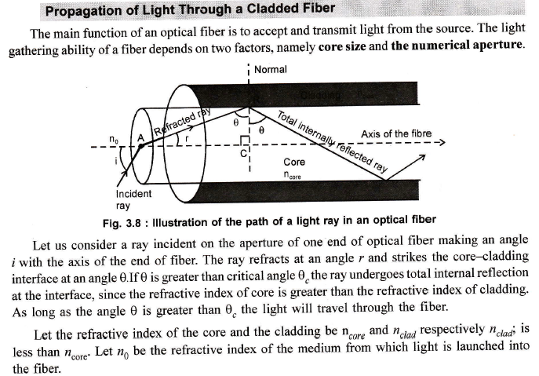

Slide 11
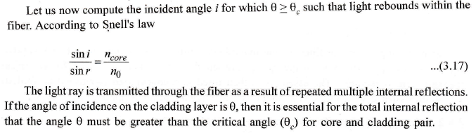
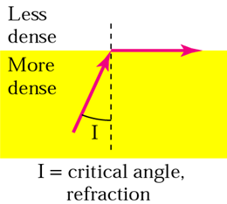
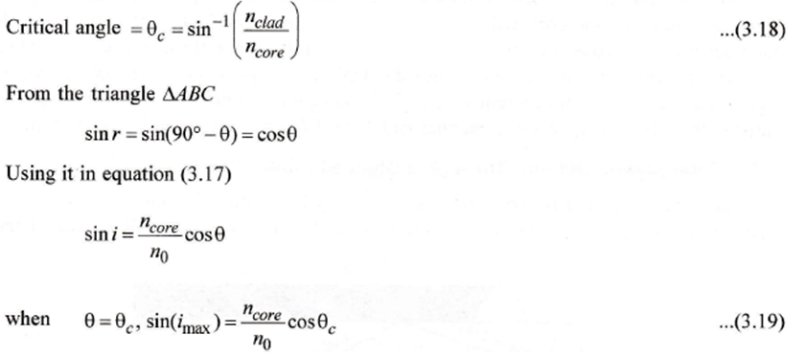
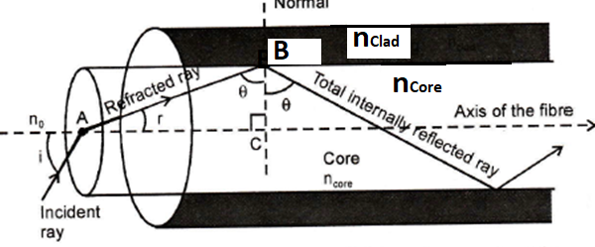
from Snell law at Air and Core Interface => n_{o} Sin i = n_{core} Sin r
from Snell law at Core Cladding Interface
n_{core} Sin θ_{c} = n_{clad} Sin 90⁰

Slide 12

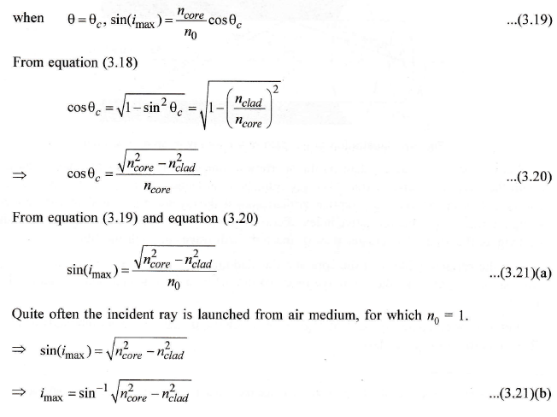
imax = Acceptance Angle

Slide 13
Derivation of numerical aperture Second method

Slide 14
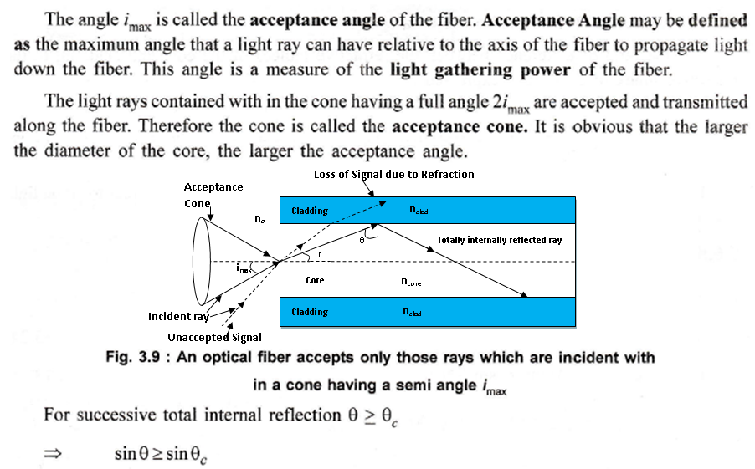
Acceptance Angle (imax) :-
The maximum angle of incidence at the end face of an Optical fiber for which the light ray can be propagated along Core-Cladding interface is known as maximum Acceptance angle. It is also called Acceptance cone half angle.

Slide 15
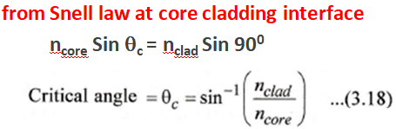
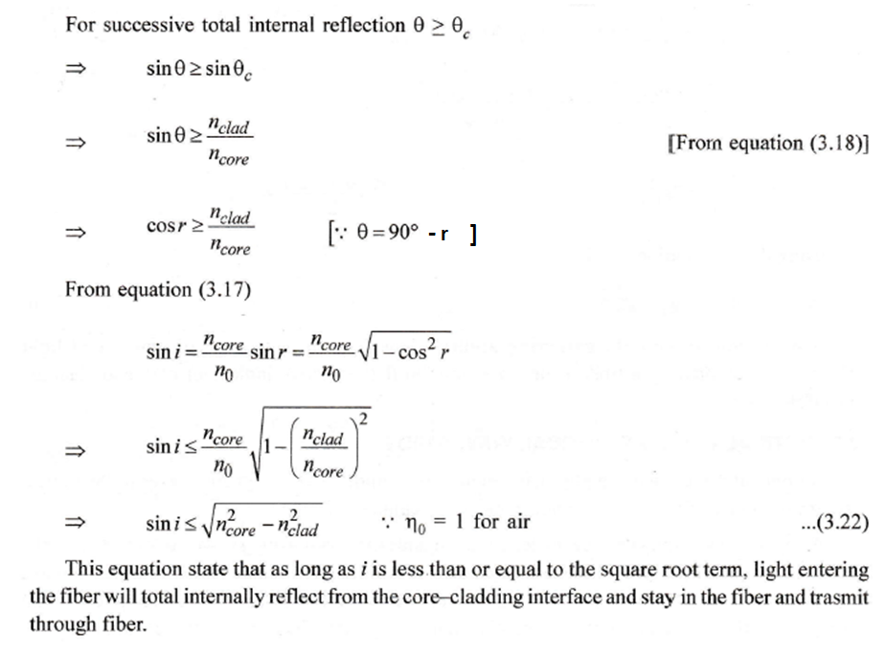

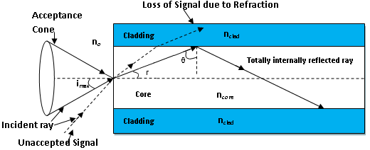
From Snell’s Law

Slide 16
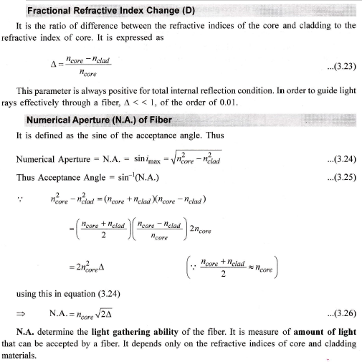

Slide 17
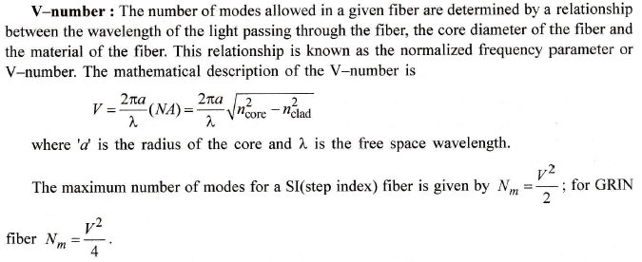
For single mode optical fiber V ≤ 2.405
For multimode optical fiber V ˃ 2.405

Slide 18
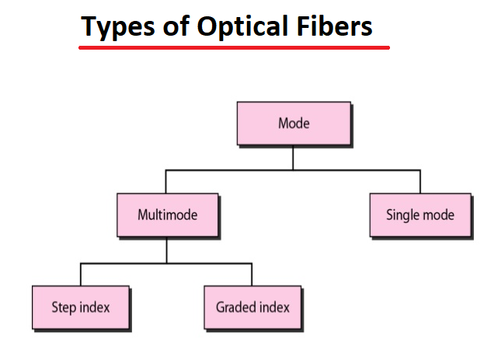

Slide 19
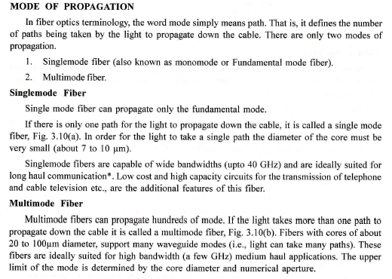

Slide 20
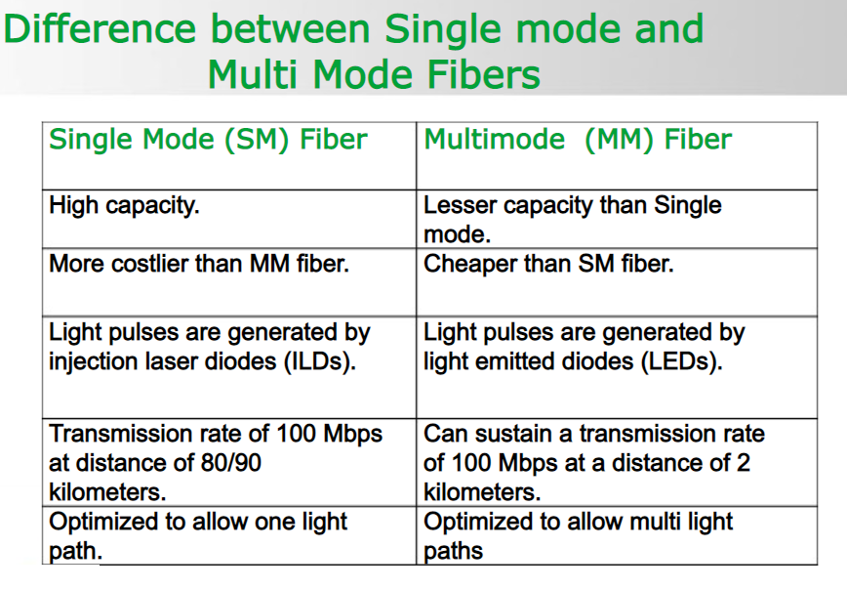
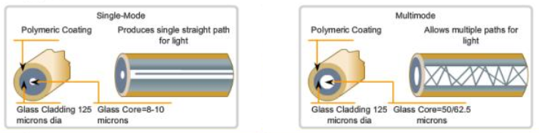

Slide 21
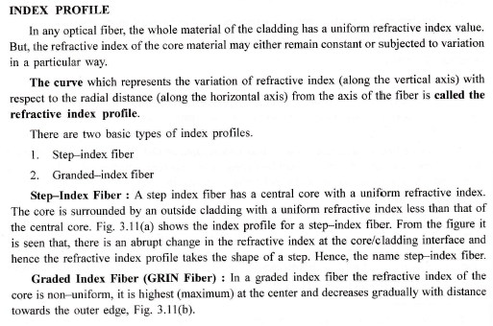
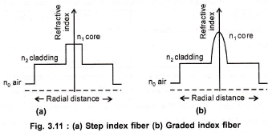

Slide 22
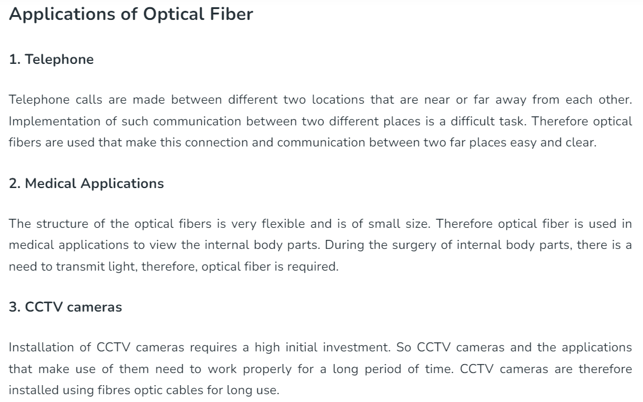

Slide 23
